Slide 1

Department of Dine’ Education
Academic Profiles of Schools Serving Navajo Students.
Presented on 04/22/10
DEPARTMENT
of
DINÉ
EDUCATION

Slide 2
Purpose
The purpose of this presentation:
1. To provide demographic information on Navajo Nation schools.
2. To provide academic profiles of Navajo Nation Schools.
3. To share information on AYP status of schools serving Navajo students.
4. To provide information on Dropout rates on the Navajo Nation.
DEPARTMENT
of
DINÉ
EDUCATION

Slide 3
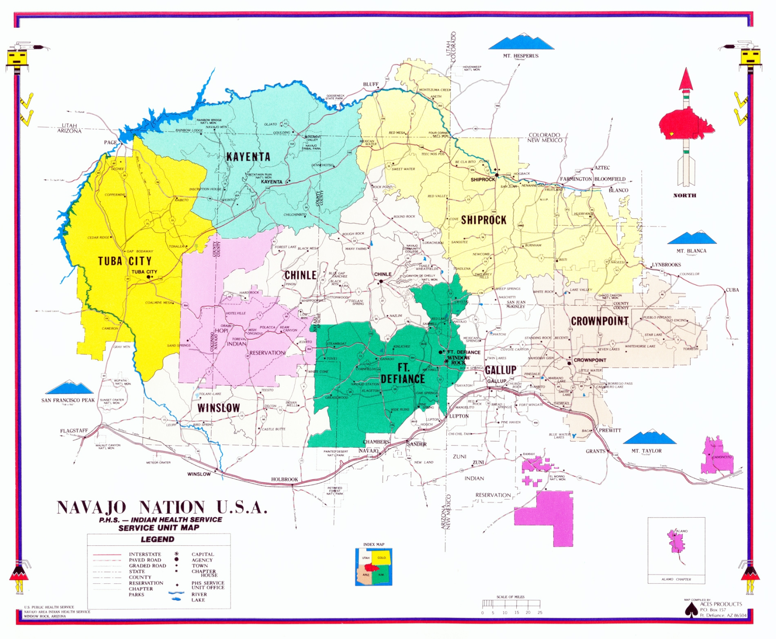
Navajo Nation Map

Slide 4

School Types on the Navajo Nation
BIE Operated
BIE Grant
BIE Contract
BIE Dormitory
Department of Diné Education
Public
Arizona, New Mexico, Utah
Parochial
Private
Mission

Slide 5
Enrollment Demographics - SY 2008-09 Count: Districts, Schools & Students
Enrollment Demographics - SY 2008-09
Institution | Location | # of Districts | # of Schools | Enrollment
Arizona Public Schools | On Navajo | 11 | 43 | 16,133
Arizona Public Schools | Off Navajo | 4 | 29 | 12,853
Arizona Charter Schools | On Navajo | 4 | 5 | 236
 |  |  | 77 | 29,222
New Mexico Public Schools | On Navajo | 2 | 27 | 7,302
New Mexico Public Schools | Off Navajo | 7 | 61 | 28,480
 |  |  | 88 | 35,782
Utah Public Schools | On Navajo | 1 | 5 | 940
Utah Public Schools | Off Navajo | 1 | 7 | 1,949
 |  |  | 12 | 2,889
OIEP-BIE Funded School | On Navajo | 6 | 59 | 14,592
OIEP-BIE Funded Dormitories | Off Navajo | 3 | 8 | 820
 |  |  | 67 | 15,412
Arizona Private Schools | On Navajo | 1 | 6 | 503
Arizona Private Schools | Off Navajo | 2 | 8 | 740
 |  |  | 14 | 1,243
New Mexico Private Schools | On Navajo | 1 | 2 | 13
New Mexico Private Schools | Off Navajo | 1 | 7 | 1,176
 |  |  | 9 | 1,189
Utah Private School | On Navajo | 1 | 1 | 21
 |  |  | 1 | 21
 |  | Total: | 268 | 85,758
Source: State Department of Education

Slide 6
Enrollment Demographics SY 2008-09 Count: On & Off Navajo
Source: State Department of Education

Slide 7
Navajo Nation Enrollment Percentage By State
Enrollment Percentage By State SY 2008-09
Institution | 2008-09
Arizona | 35%
New Mexico | 43%
Utah | 3%
BIE | 19%
 | 100%
Enrollment Percentage: BIE vs. Tri-State Public Schools SY 2008-09
Institution | 2008-09
AZ, UT, NM Combined | 81%
BIE | 19%
Source: State Department of Education

Slide 8
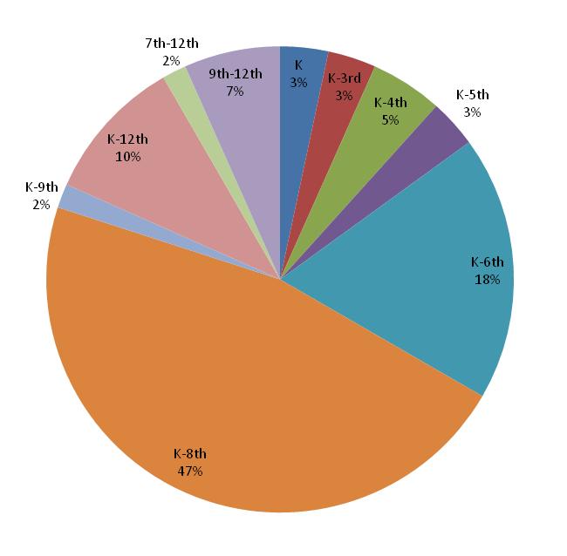
BIE School Breakdown School Count by Grade Range

Slide 9
Source: State Department of Education

Slide 10
Source: State Department of Education

Slide 11
Adequate Yearly Progress (AYP) Summary SY 2008-09
Source: State Department of Education

Slide 12
Source: State Department of Education

Slide 13
BIE Schools in Restructuring Status
 | 0 Year | 1 Year | 2 Years | 3 Years | 4 Years | 5 Years | 6 Years
Number of Schools | 20 | 13 | 1 | 5 | 3 | 8 | 10
Percentage of Schools | 33.3% | 21.7% | 1.7% | 8.3% | 5.0% | 13.3% | 16.7%
Source: BIE - OIEP

Slide 14
Dropout Rate
The following information was obtained on Dropout rates on State Education Department
AZ, NM, Utah, BIE
DEPARTMENT
of
DINÉ
EDUCATION

Slide 15
Native American Dropout Rates
Compared by State
source: public education department, 2006 – 2009 dropout report

Slide 16
Contact Information: Office of Educational Research & Statistics Telephone: (928) 871-7616 Fax: (928) 871-6744 Mailing Address: Post Office Box 670 Window Rock, Arizona 86515 www.odsmt.org
DEPARTMENT
of
DINÉ
EDUCATION

